Slide 1
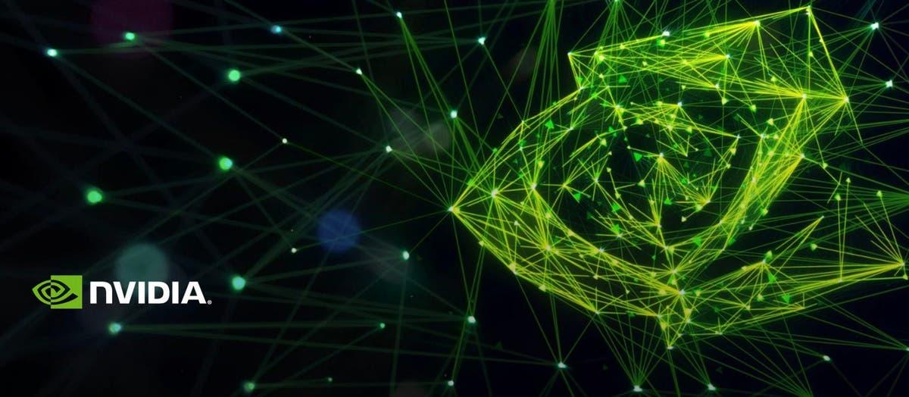
Data Analysis of Nvidia Stock
Presented by: Tuvshin Dashtseren

Slide 2
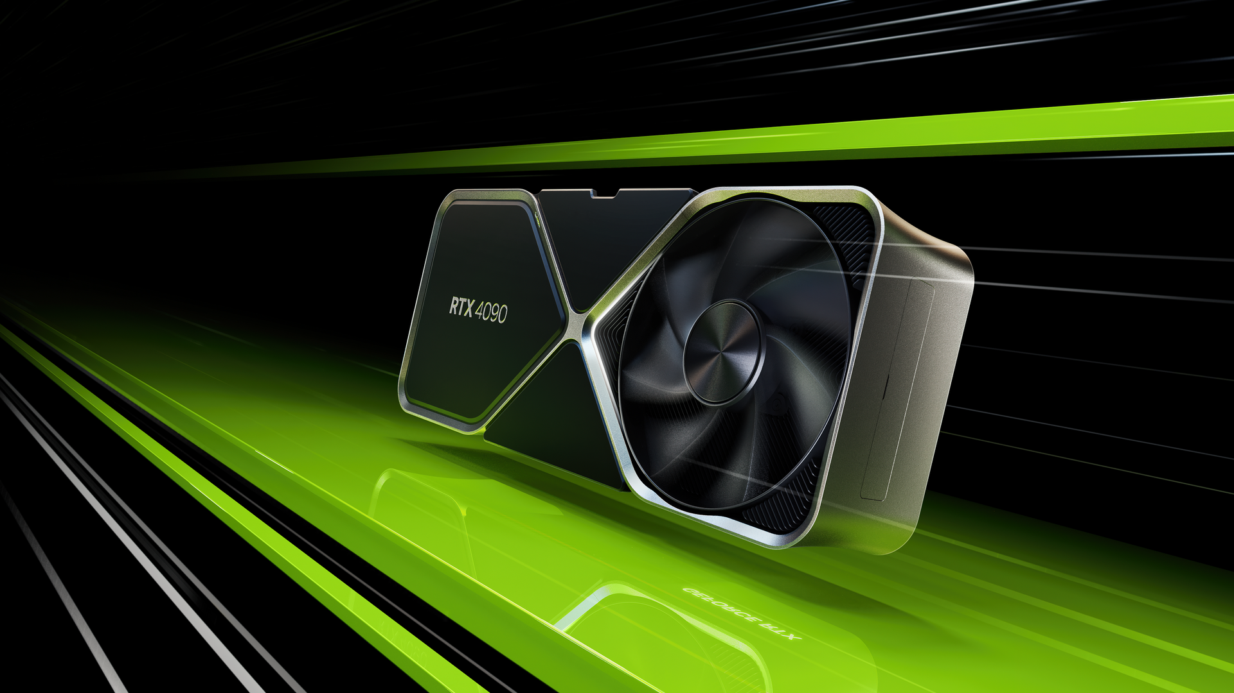
About Nvidia
Nvidia is a renown technology company that specializes in computer hardware such as graphics cards. Nvidia is also responsible for the development of A.I using Nvidia’s hardware. Their professional line of GPUs (Graphical Processing Unit) is utilized for a number of processes such a 3D Modeling, Video Editing, Gaming, and more. Nvidia’s top customers consist of Dell, Amazon, Google, Microsoft, Meta, and more.

Slide 3
About My Data Set
The data set I have chosen is from Kaggle. The stock price history dates all the way back from 1999 to 2023. I chose Nvidia because I wanted to discover insights before investing into more shares. I have used their products before and I believe Nvidia is a company that is highly relevant in the world of technology.
Find the data set here

Slide 4
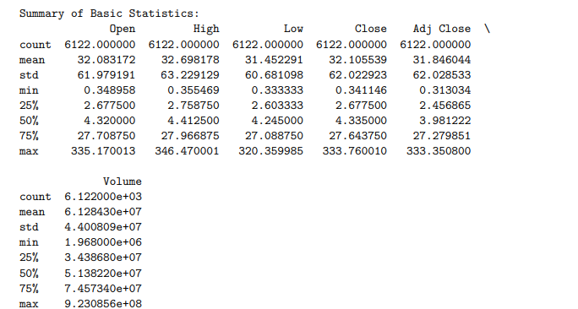
Here it is!

Slide 5
Just kidding, this is not very data literate..

Slide 6
Imported Libraries
pandas (pd): Used for data manipulation and analysis. It provides data structures like DataFrame for efficiently storing and manipulating large datasets.
train_test_split from sklearn.model_selection: Used for splitting the dataset into training and testing sets.
LinearRegression from sklearn.linear_model: Implements linear regression models.
PolynomialFeatures from sklearn.preprocessing: Generates polynomial and interaction features. Used to create polynomial features for polynomial regression.
make_pipeline from sklearn.pipeline: Used to construct a pipeline from a list of transformers and a final estimator. In this case, it's combining PolynomialFeatures and LinearRegression.
mean_squared_error from sklearn.metrics: Computes the mean squared error between the actual and predicted values. Used for evaluating the performance of the regression model.
matplotlib.pyplot as plt: A plotting library used for creating visualizations, such as the scatter plot and line plot in this code.
import seaborn as sns: Seaborn is used for creating more advanced and aesthetically pleasing visualizations, such as heatmaps, pair plots, and violin plots, in this code. It complements matplotlib for data visualization tasks.

Slide 7
Visualizations
-Interactive line plot
-Bar Graphs
-Violin Plot
-Correlation Matrix
-Plot Pairs

Slide 8
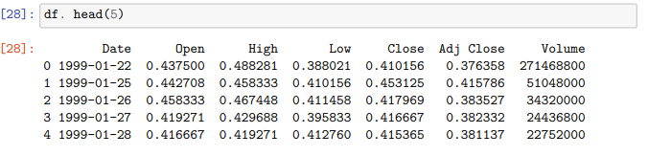

Slide 9
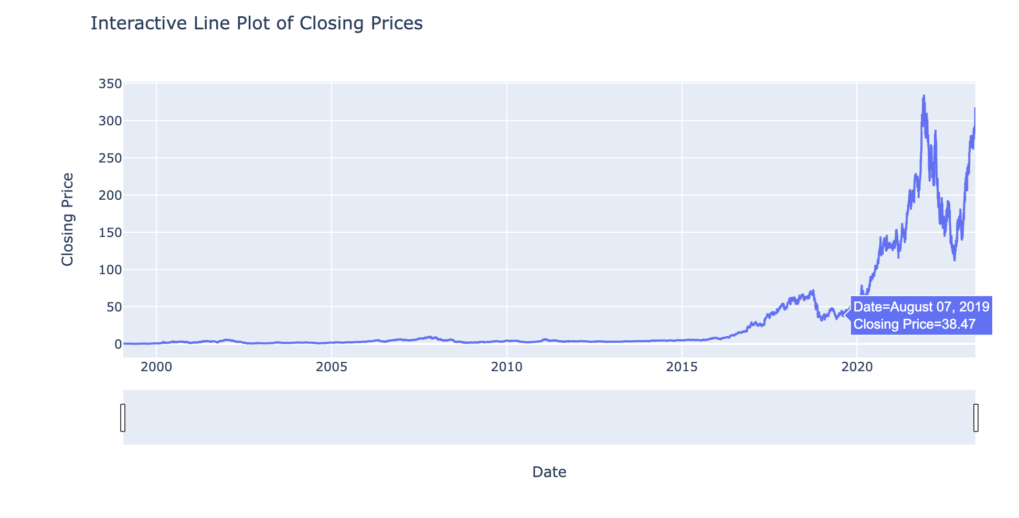
Interactive Line Plot

Slide 10
Interactive Line Plot
This graph allows for seamless prices checks through our historical data. It is very useful for comparing prices throughout the years.

Slide 11
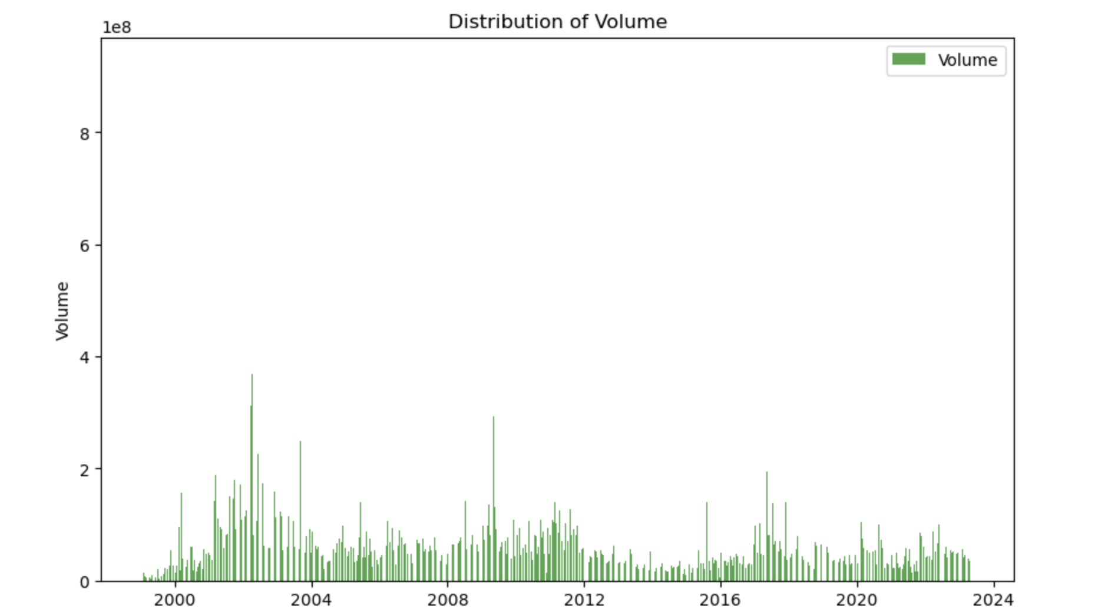
Bar Chart

Slide 12
Bar Chart
Another simple, yet effective way to visualize the distribution of volume of Nvidia shares being traded.

Slide 13
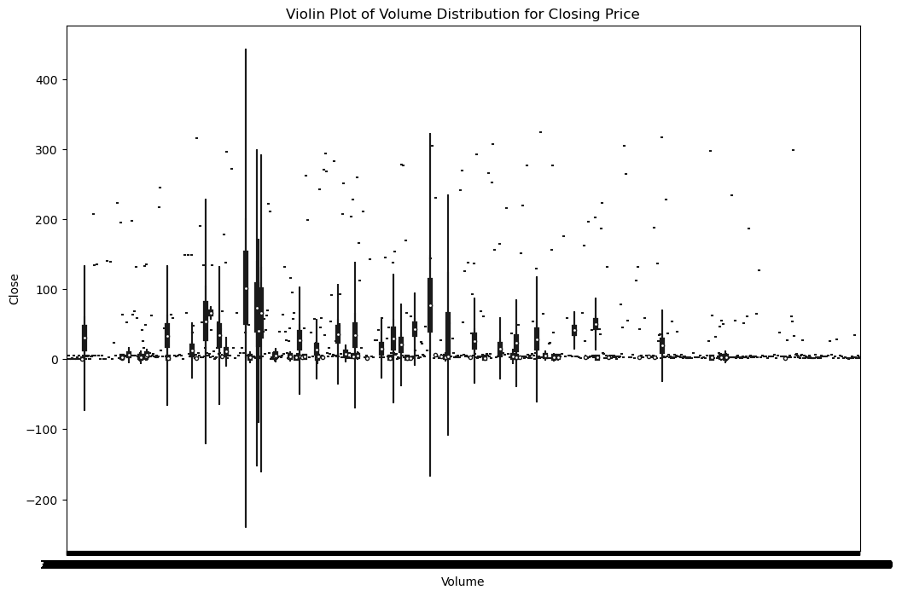
Violin Plot

Slide 14
Violin Plot
the white dot represents the median
the thick black bar in the center represents the interquartile range
the thin black line represents the rest of the distribution, except for points that are determined to be “outliers” using a method that is a function of the interquartile range.

Slide 15
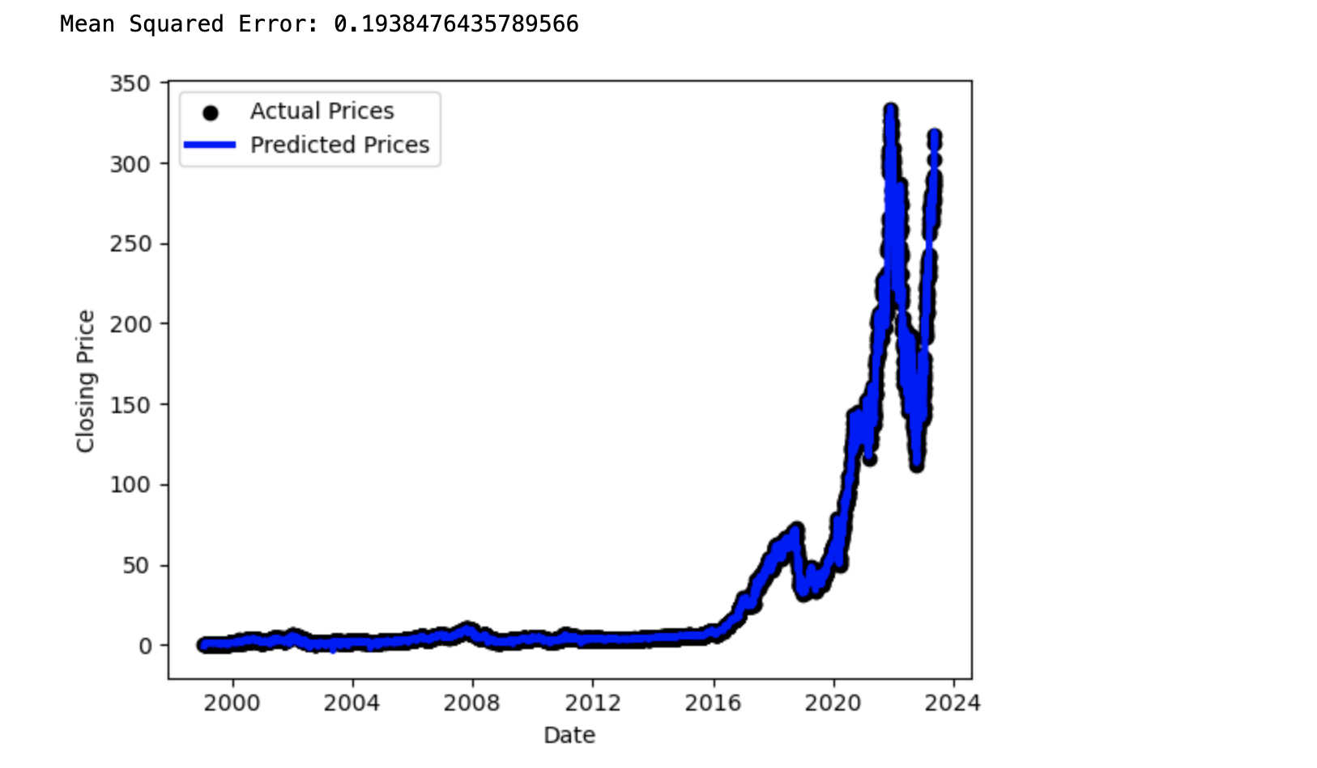
Predictive Model

Slide 16
Predictive Model
Utilizes machine learning or statistical techniques to analyze historical data and learn patterns, which can then be used to predict future outcomes or trends.

Slide 17
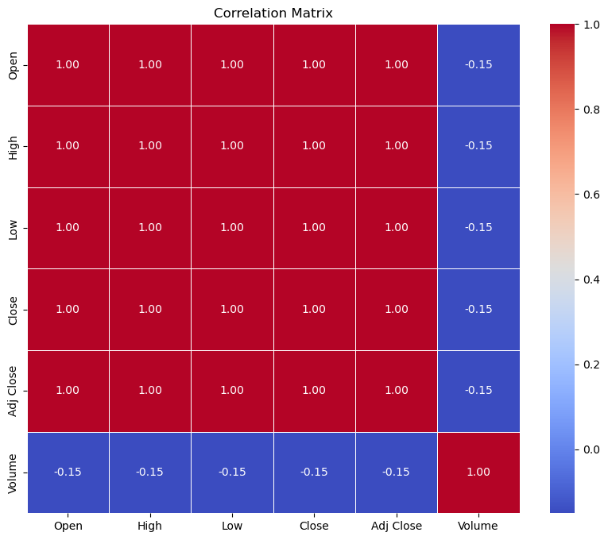
Correlation Matrix

Slide 18
Correlation Matrix
Look at the number in each cell to see the strength and direction of the correlation.
Positive numbers indicate positive correlations, while negative numbers indicate negative correlations.
The closer the number is to 1 (or -1), the stronger the correlation.

Slide 19
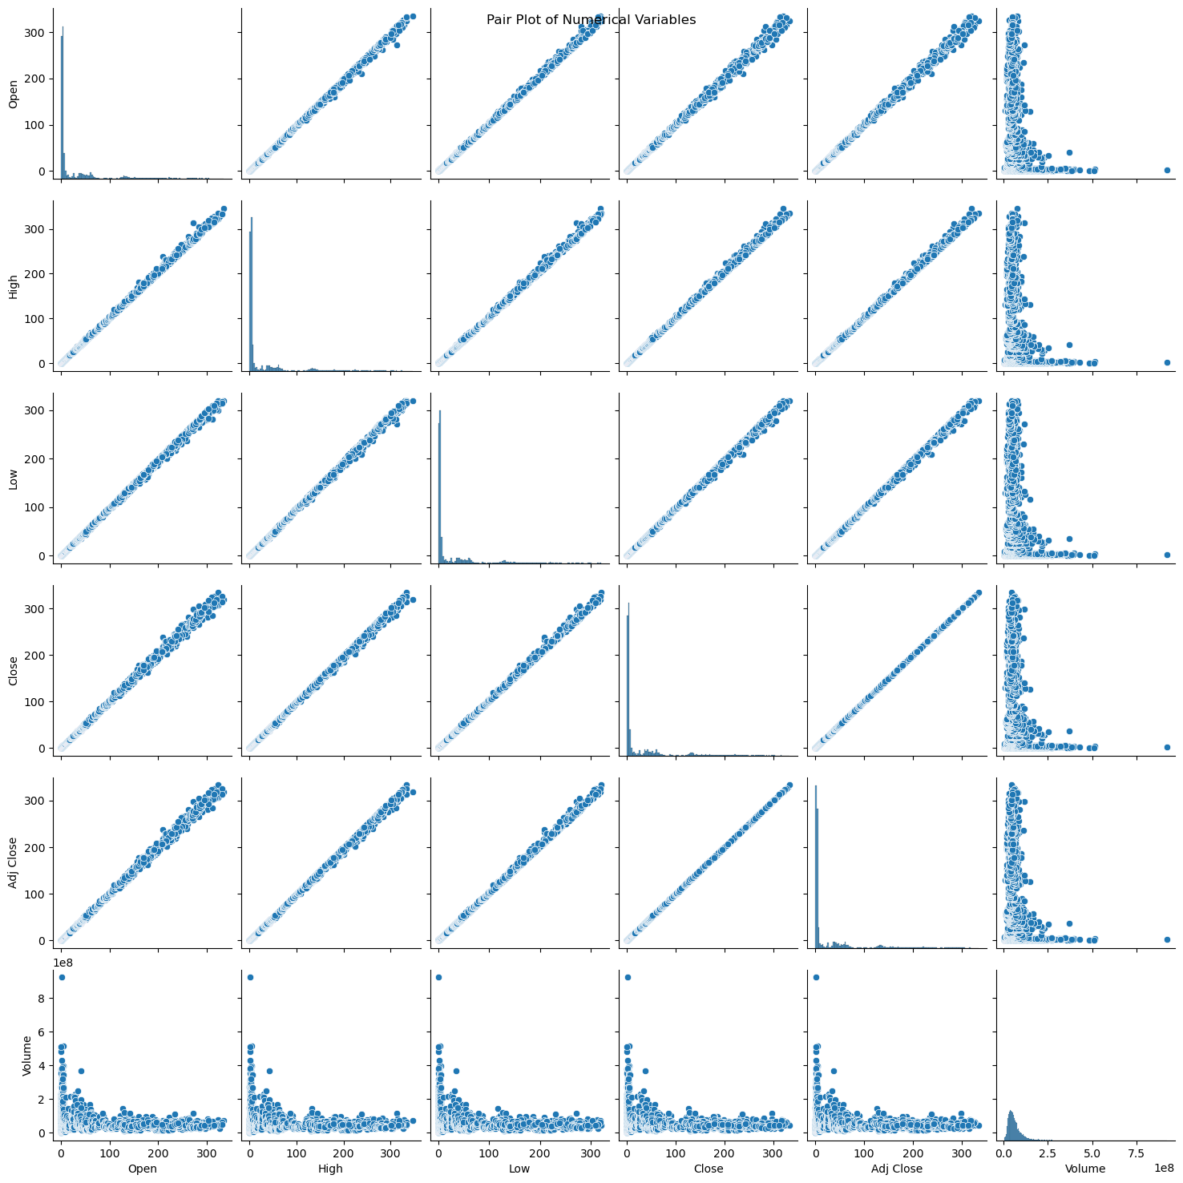
Pair Plot

Slide 20
Pair Plot
The Seaborn Pairplot allows us to plot relationships between variables within a dataset.

Slide 21
Data Driven Insights
if you bought NVDA stock one year ago, Oct 14, 2022, for the price of $115 you would have successfully tripled your investment.
What is more astonishing is Pre-COVID NVDA was only selling at $33 June 3, 2019. This means if you had bought one share
you would have 10X your investment. To put that into scale you had invested your weekly paycheck of $500 your return would be roughly $4500.
Based on the interactive chart NVDA is at a all time high. In comparison with volume, many people are choosing to hold their shares.
With the recent advancements within AI computers need better processing power for research and development.

Slide 22
Data Driven Insights
We see that the price dropped drastically a year ago due to speculation of a recession.
I predict that there will be another drop similar to Oct 14, 2022. Because, the NVDA stock is at a all time high.
We see from historical data that after a rise in price, the stock tends to lower in price, than quickly escalate.

Slide 23
In Conclusion
Nvidia has a high potential for growth over the next years. Data from our investigation indicates that it is on an upwards trend with lower volumes of shares being traded. This means that the price per share is increasing and investors are deciding to hold rather than sell. This could be because of the influence of Nvidia on the development of Large Language Models and A.I. In addition, revenue from many larger companies such as Amazon, Microsoft, and Google create a stable source of income. Nvidia is likely to be bullish in the upcoming year given the data and background knowledge of the market.

